Slide 1
CO2 Emmision Prediction PROJECT

Slide 2
Team and Mentor
Mentor- Karthik Muskula
Co-Ordinator- Bapuram Pallavi
Namrata Athawale
Jerome Robert
Saiprasad Shidheshware

Slide 3
Table of contents
01.
02.
03.
The project
Objectives
Dataset details
04.
05.
06.
EDA
Model
Challengesd

Slide 4
Project Objective
Expected outcomes
Main goals
target
Develop a machine learning model to predict CO2 emissions based on car engine specifications.
Gain insights into emission patterns, enhance predictive capabilities, and support informed environmental policy decisions.
Identify major CO2 emission sources, analyze trends, and provide actionable insights for effective reduction

Slide 5
Dataset Description
Provided dataset contains vehicle specifications along with CO₂ emissions data. It serves as the foundation for building an accurate prediction model
Some key features:
Engine size
Cylinders
Fuel type
Transmission
Co2 Emissions
The data set contains 7385 instances with 12 variables.

Slide 6

EDA
Data Inspection
Handling missing values
Checking and removing duplicates
Summary statistics
Data Visualization

Slide 7
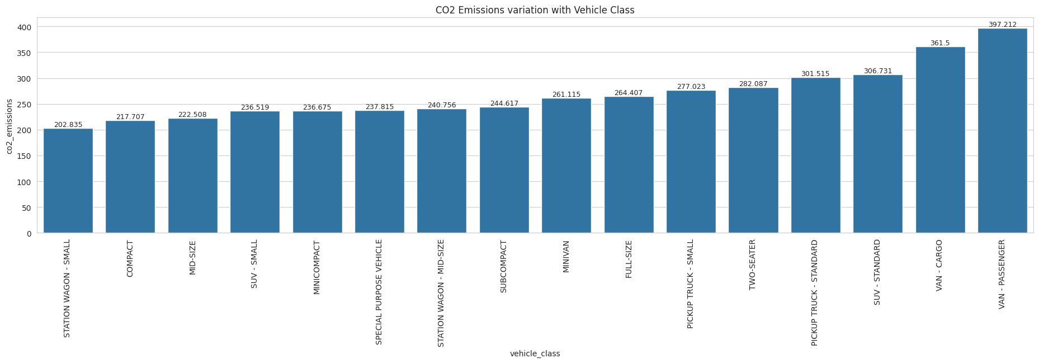
Histogram
Smaller vehicles emit less CO2 – Compact, mid-size, and subcompact cars have lower emissions, with Station Wagon - Small (~202 g/km) having the least.
Larger vehicles contribute more – Vans, pickup trucks, and SUVs have significantly higher emissions, with Passenger Vans (~397 g/km) being the highest.
Size and engine capacity impact emissions – As vehicle size increases, CO2 emissions rise, highlighting the need for fuel-efficient and hybrid alternatives.

Slide 8
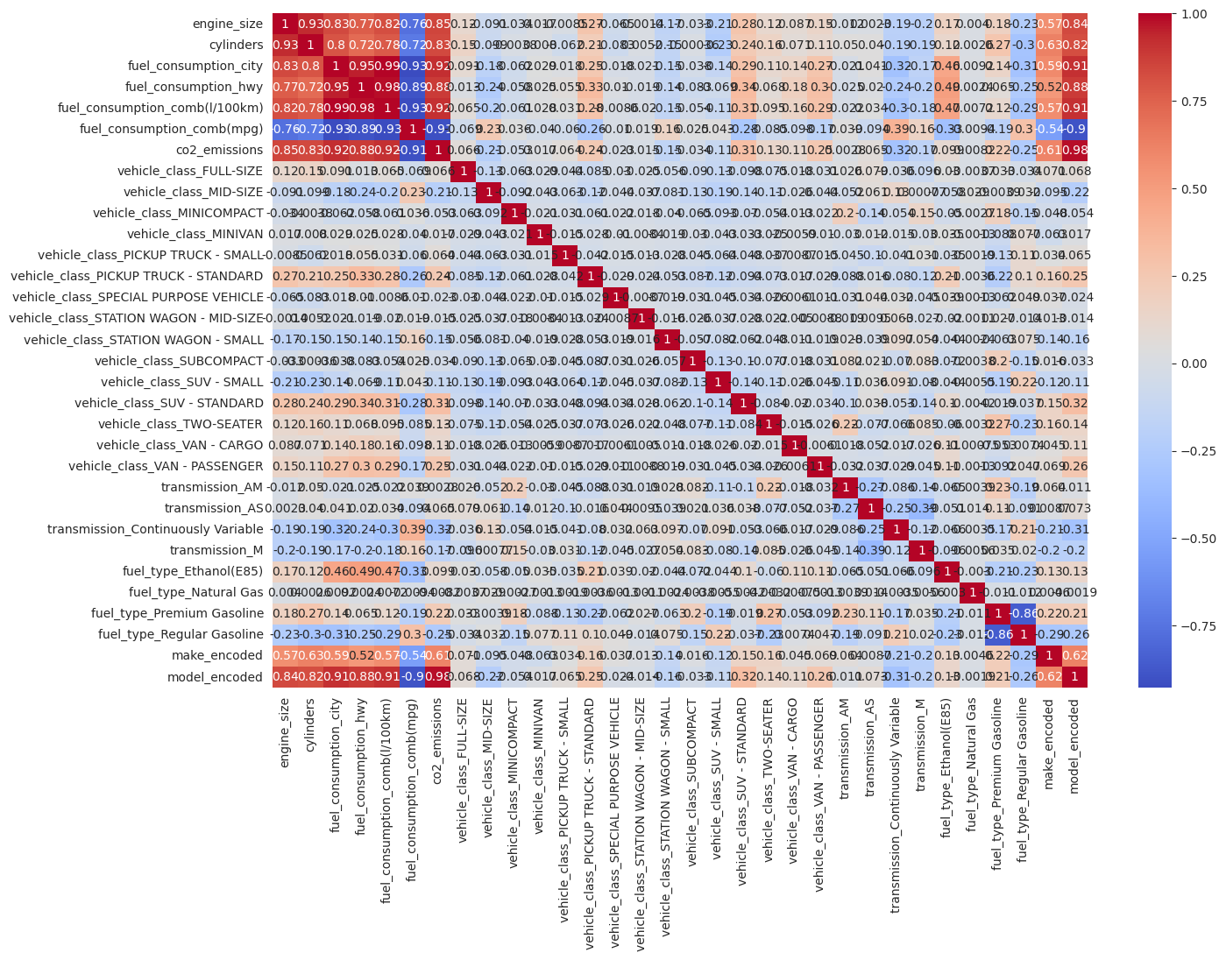
Correlation heatmap
.
Larger engines and higher fuel consumption increase CO2 emissions.
Hybrid and electric vehicles produce lower CO2 emissions.
SUVs and trucks emit more CO2 than smaller cars.

Slide 9
Data Preparation
Encoded categorical variables (fuel type, transmission).
Scaled numerical features using StandardScaler.
Split data into 80% training and 20% testing.

Slide 10
Models
Linear Regression
KNN
Random forest
SVR
Captured patterns but prone to overfitting
Simple but struggled with non limarity
Tested for better handling of non-linearity.
Performed well with strong generalization

Slide 11
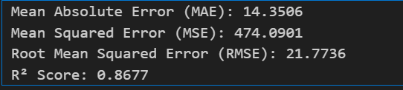
Linear Regression
While Linear Regression provides a simple and interpretable model, its assumptions and limitations make it less ideal for predicting CO2 emissions, where non-linear relationships exist.

Slide 12
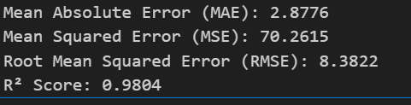
KNN
Despite great accuracy, KNN is impractical for real-world use due to high computational cost and memory requirements.

Slide 13
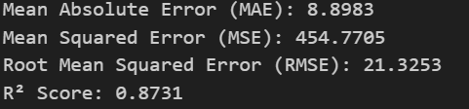
SVR
SVR was slower,showed greater error score

Slide 14
Random Forest
Achieved low MAE (3.33) and RMSE (8.75) with an R² Score of 0.98, ensuring strong predictive power.

Slide 15
Hyperparameter Tuning
Reason to use hyperparameter tuning:
To Improve Model Performance
To Prevent Overfitting
To Optimize Computational Efficiency
To Find the Best Model Configuration

Slide 16
Model Selection criteria
Random Forest was the best model for CO2 emissions prediction.
Handles Non-Linearity
Robust to Outliers & Noise
High Accuracy & Low Error
Feature Importance Analysis
Better Generalization
Scalability & Efficiency

Slide 17
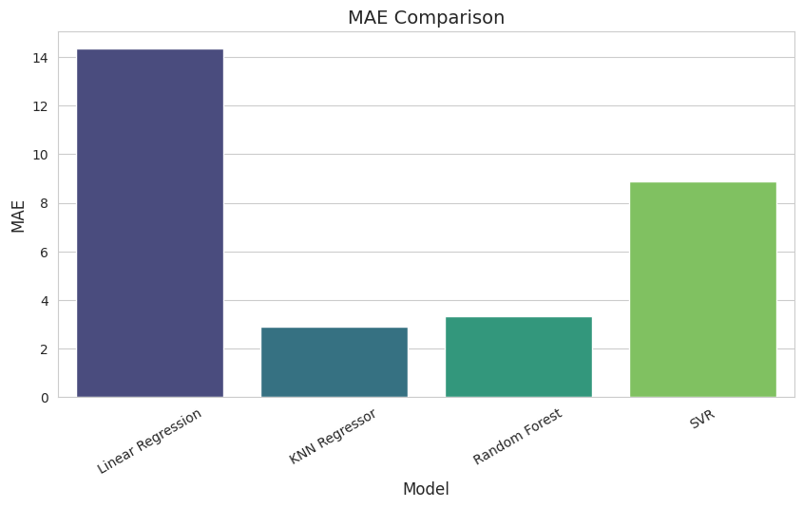
MAE Comparison
Linear Regression has the highest error.
Random Forest and KNN Regressor show lower MAE.
SVR performs moderately but is less effective than Random Forest.

Slide 18
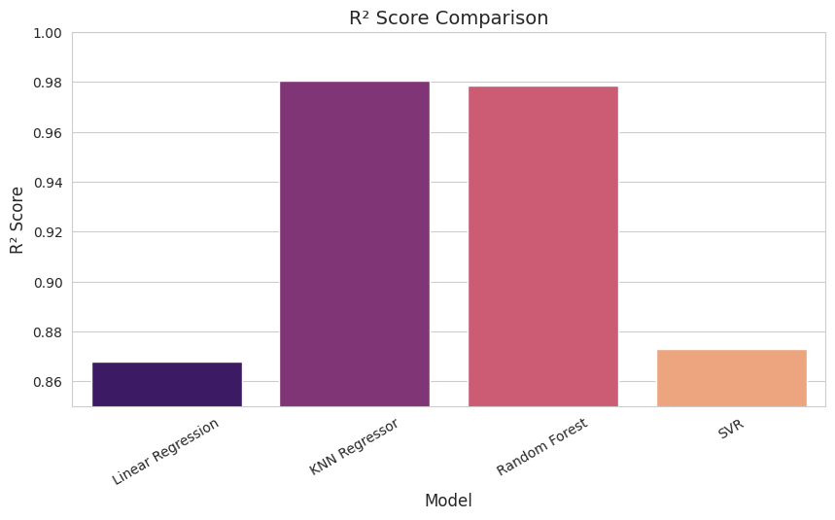
R2 Score Comparison
Regressor and Random Forest have the highest R² scores, indicating better model performance.
Linear Regression and SVR have lower R² scores, showing less accurate predictions.

Slide 19
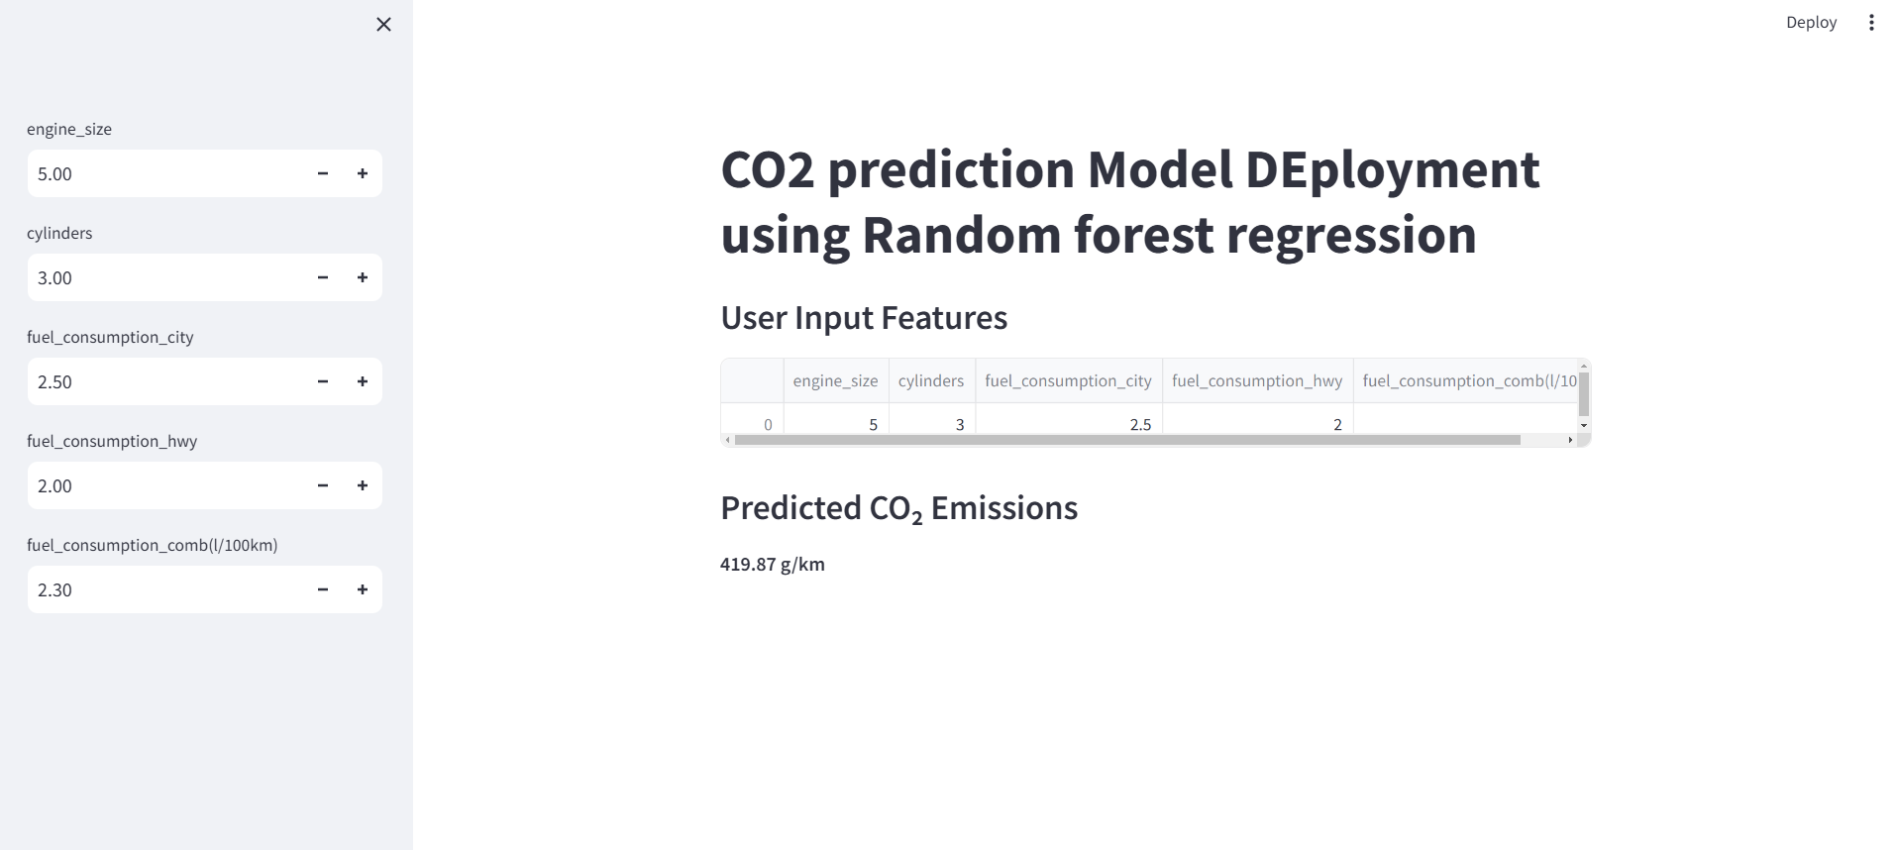
APP Page

Slide 20
Challenges faced
Data Quality Issues
Feature Selection Complexity
Hyperparameter Tuning
Model Deployment Challenges

Slide 21
Thank You !

